Slide 1
search of Alfvén waves in faculae
A.Chelpanov, N.Kobanov, and S.Chupin
Institute of Solar–Terrestrial Physics, Irkutsk
Irkutsk, 2017
Notes:
This report presents a study of …

Slide 2
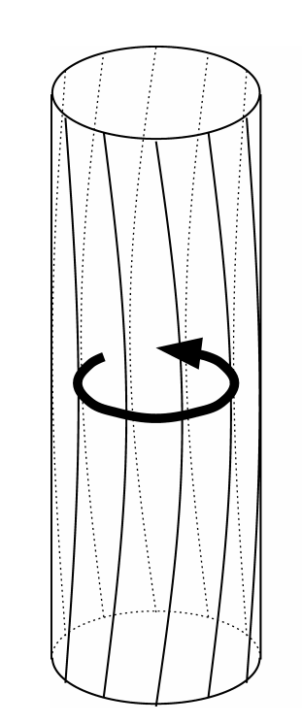

Motivation and observational signatures
Torsional mode
incompressible
do not perturb density
do not modify emission
Notes:
Pose a plausible mechanism for transporting non-thermal energy, but notoriously difficult to observe. It’s incompressible … The tube, when observed transversely from a side, emits both positive and negative Doppler shift signal.

Slide 3

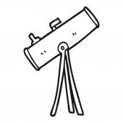
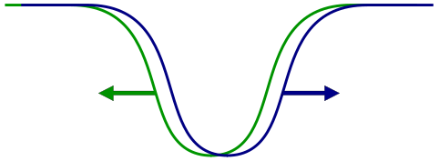
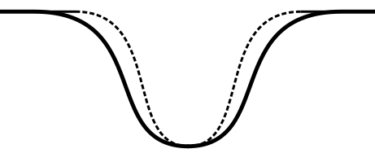
Motivation and observational signatures
Torsional mode
observed movements
Notes:
Pose a plausible mechanism for transporting non-thermal energy, but notoriously difficult to observe. It’s incompressible … The tube, when observed transversely from a side, emits both positive and negative Doppler shift signal.

Slide 4
Motivation and observational signatures
Observed indirectly by measuring the line broadening.
Notes:
Pose a plausible mechanism for transporting non-thermal energy, but notoriously difficult to observe. It’s incompressible … The tube, when observed transversely from a side, emits both positive and negative Doppler shift signal.

Slide 5
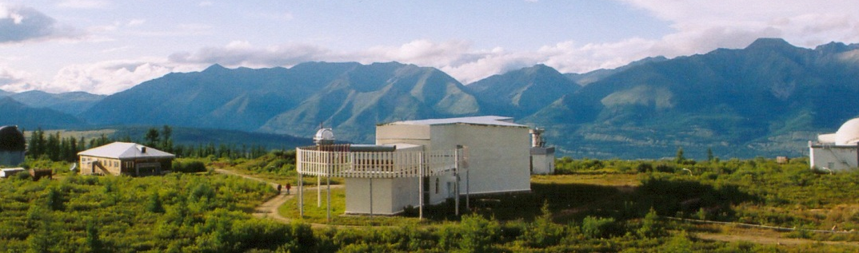
Instrument and Data
Spectral observations
2000 m above sea level
D = 0.8 m
resolution 1.0 –1.5’’

Slide 6
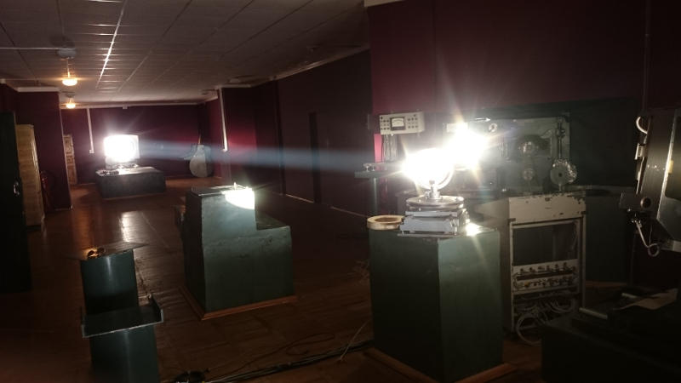
Instrument and Data
Chromospheric lines Hα 6563 Å and He I 10830 Å together with photospheric lines Ba II 4554 Å and Si I 10827 Å
40–150 minute series
2–5 s time resolution
Different centre-limb locations

Slide 7
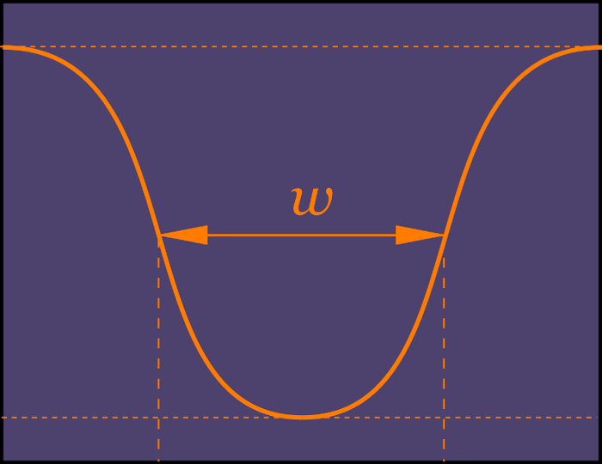
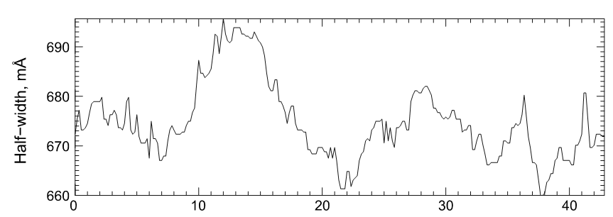
Method
½ I —
peak-to-peak amplitude

Slide 8
Peak-to-peak amplitudes
Photosphere
Chromosphere
Si I 9–12 mÅ
Ba II 2–5 mÅ
Hα 20–50 mÅ
He I 40–70 mÅ

Slide 9
Results
Do these oscillations result from temperature variations?

Slide 10
Results
observed
ΔI
ΔT
from Planck's law
ΔI < 5%
Δλ_{I/2} < 3 mÅ
ΔT
Δλ_{I/2}

Slide 11
Results
ΔI < 5%
Δλ_{I/2} < 3 mÅ
The observed peak-to-peak amplitudes are 20–70 mÅ

Slide 12
Results
Temperature variations do not cause these oscillations.

Slide 13
Results
Doppler shifts
Hα
50 mÅ increase
1100 m/s velocities

Slide 14
Results
Sausage mode?

Slide 15
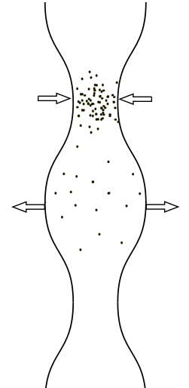

Sausage mode

Slide 16
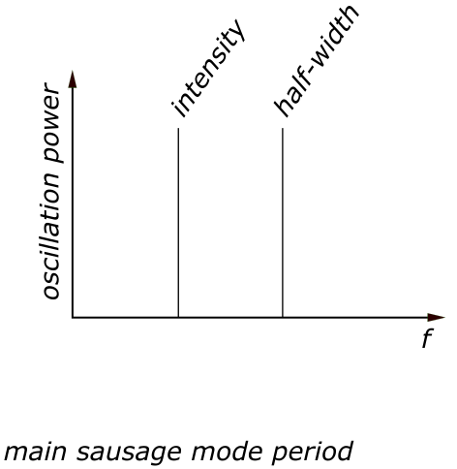
Sausage mode
Notes:
In some cases, though, the parameter behaviours are somewhat related. Below we give plots of half-width and intensity for some points of other faculae, where the Fourier spectra look very similar. For series 2003-07-01 the phase difference between the intensity and half-width oscillations is π/2. For 2012-09-21 series these parameters oscillate in-phase, both for the Hα and He I. Such behaviour can indicate the acoustic component in the observed MHD waves.

Slide 17
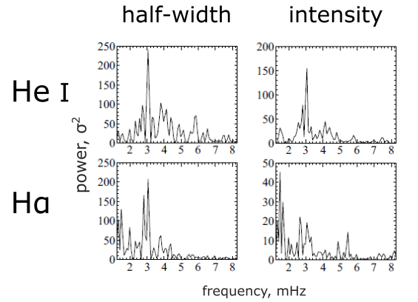
Sausage mode

Slide 18
Results
Half-width
intensity
Notes:
To understand the nature of the waves that produce these half-width oscillations, and, more specifically, to answer the question whether they are Alfven waves, we need to analyze the behaviour of the other parameters available in our observations. These are line-of-sight velocity oscillations and intensity oscillations, which I’ve already mentioned. The relationships between the oscillations of these parameters can give us the clues on the modes of the MHD waves that we obseerve.
The patterns of these relationships differ in our observations. This is an example of spatial points that show no evident relation, though the oscillations are clearly seen with the naked eye. The Fourier spectra plots on the right show no relation either.

Slide 19
Results
He I 10830 Å profile
• Photoionization-recombination mechanism
UV-radiation
He II 304 Å oscillations?
• Collisional mechanism
Energetic particles

Slide 20
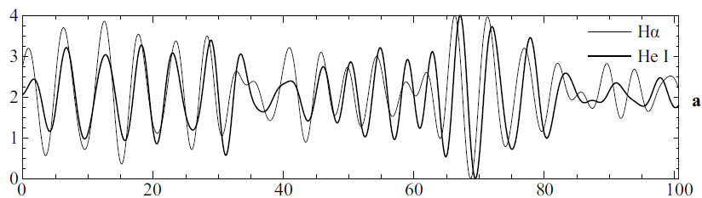
Results

Slide 21
Results
He I 10830 Å profile
• Photoionization-recombination mechanism
UV-radiation
He II 304 Å oscillations?
• Collisional mechanism
Energetic particles

Slide 22

McClements et al., 1991
A simple method of testing the hypothesis that coronal heating is brought about by Alfvén wave dissipation involves the tracking of active region from disk centre to limb (and vice versa).

Slide 23
Results
No centre-to-limb variation observed.
No torsional mode?

Slide 24
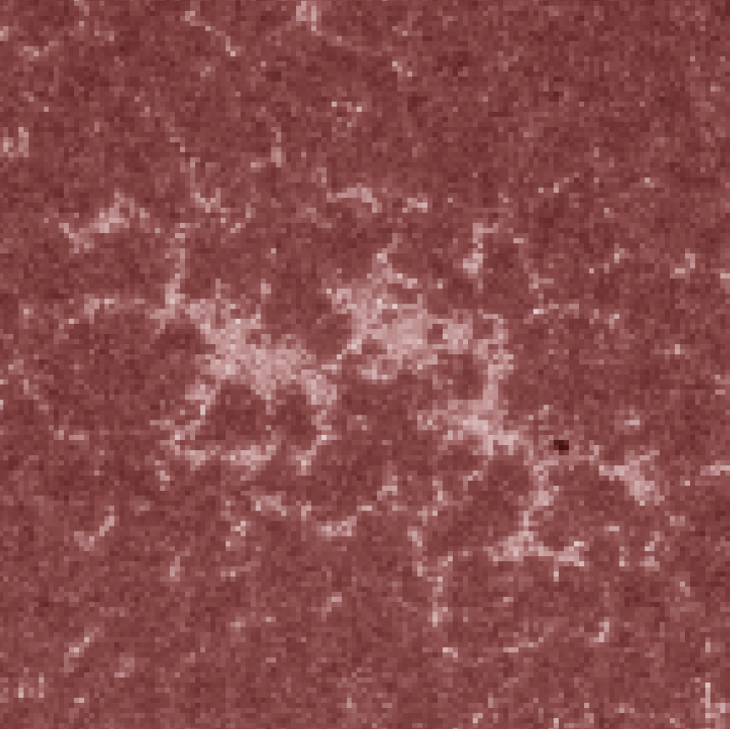
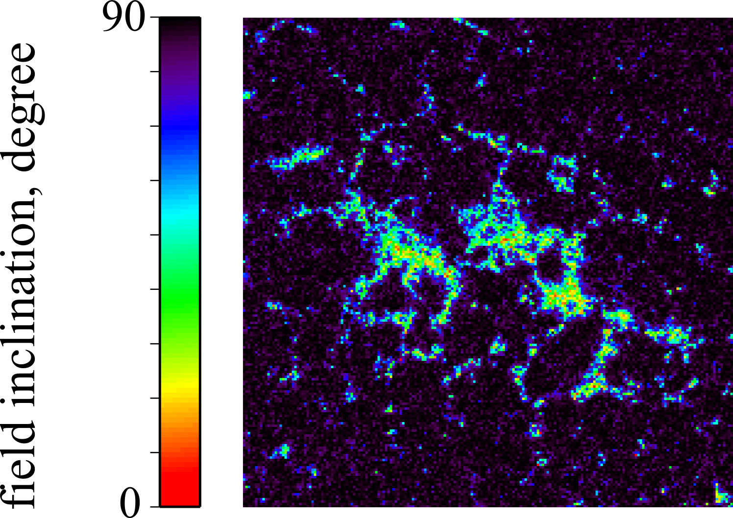
Results
AIA 1700 Å
SDO/HMI

Slide 25
thank you
Notes:
This report presents a study of …

