Slide 1
Inversed Lagrangian approach for 3D MHD simulations
Ulyanov Artem, LPI RAS, Moscow
artem.ulianov@gmail.com
Russian-British Seminar of Young Scientists “Dynamical plasma processes in the heliosphere: from the Sun to the Earth”
18 - 21 September 2017, Irkutsk, Russia
Notes:
First of all I would like to thank David Pascoe, who made a great talk on Monday. He left me not so much to add on the topic, but I’ll try. Also I will show one mathematical trick that may improve MHD simulations in Lagrangian coordinates. The spirit of this trick hides in the word Inversed in the title.

Slide 2
Hardware, software…
CPU: Intel core-i5 3.4 ГГц
Memory: 8 Гб
Graphics: Nvidia GeForce GTX 680 2 Гб
Python 2.7
GPGPU: OpenCL
Computation time (64x64x256 grid): approx. 15 min
Visualization: Matplotlib, OpenGL, OpenCV
http://github.com/temik42/
Notes:
Before I start I want to present you information concerning the technical part of my work. I run my code on a simple PC with an average configuration. The code is partially written in Python, partially on C. I use OpenCL for GPGPU to accelerate the computations. For example the computation time for 3d simulations that I will show you at the end of my talk amounts to approximately 15 minutes. Furthermore all the source code will be soon available on my github account.

Slide 3
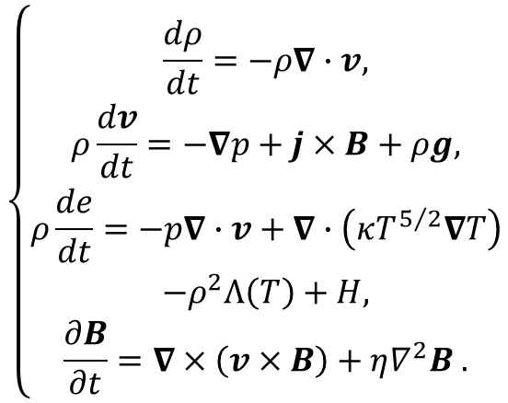

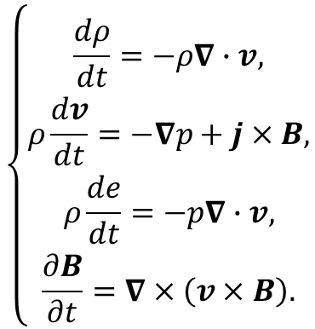
MHD equations
Non-ideal plasma
Ideal plasma
$$\left\{\begin{aligned} \\ \frac{dρ}{dt}=−ρ∇∙v, \\ ρ\frac{dv}{dt}=−∇p+j×B+ρg, \\ ρ\frac{de}{dt}=−p∇∙v+∇∙\left(κT^{5/2}∇T\right) \\ −ρ^{2}Λ\left(T\right)+H, \\ \frac{∂B}{∂t}=∇×\left(v×B\right)+η∇^{2}B .\end{aligned}\right.$$
$$\left\{\begin{aligned} \\ \frac{dρ}{dt}=−ρ∇∙v, \\ ρ\frac{dv}{dt}=−∇p+j×B, \\ ρ\frac{de}{dt}=−p∇∙v, \\ \frac{∂B}{∂t}=∇×\left(v×B\right).\end{aligned}\right.$$
$$\begin{matrix}e=\frac{p}{\left(γ−1\right)ρ}, & j= \frac{1}{μ_{0}}∇×B, & ∇∙B=0.\end{matrix}$$
Notes:
So here is the system of MHD equations. For now lets constrain ourselves on an ideal case, that is we neglect the source terms, field dissipation and thermal conduction. Before we proceed to solve this equations numerical I should emphasize one important thing. The form of equations is not conservative and is not convenient for numerics. So if we start to derive the numerical scheme right from these equations, we will probably fail, as it will be inconsistent. Hence first of all we should derive an appropriate form to do numerics.

Slide 4
Eulerian approach
(Here should be an image of a man sitting on a bank of a river and looking at passing boats)
Notes:
First, I’d like to introduce the conservative Eulerian form of the equations. The Eulerian approach can be well described by a picture of a man (an observer) sitting on a bank of a river and looking at passing boats. So in the Eulerian viewpoint we consider how fluid properties vary in time at a point that is fixed in space.

Slide 5
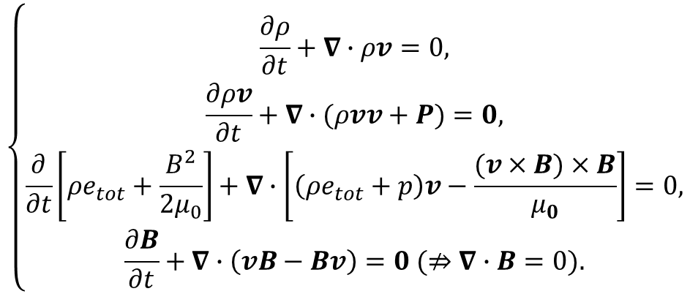
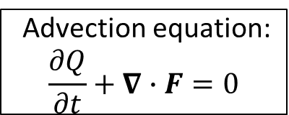
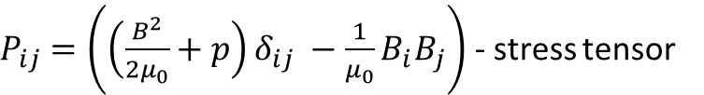

Eulerian MHD
$$\left\{\begin{aligned} \\ \frac{∂ρ}{∂t}+∇∙ρv=0, \\ \frac{∂ρv}{∂t}+∇∙(ρvv+P)=0, \\ \frac{∂}{∂t}\left[ρe_{tot}+\frac{B^{2}}{2μ_{0}}\right]+∇∙\left[\left(ρe_{tot}+p\right)v−\frac{(v×B)×B}{μ_{0}}\right]=0, \\ \frac{∂B}{∂t}+∇∙\left(vB−Bv\right)=0 (⇏∇∙B=0).\end{aligned}\right.$$
Advection equation:
$$\frac{∂Q}{∂t}+∇∙F=0$$
$e_{tot}=e+\frac{v^{2}}{2}$ - total specific energy
$P_{ij}=\left({\left(\frac{B^{2}}{2μ_{0}}+p\right)δ_{ij} −\frac{1}{μ_{0}}B}_{i}B_{j}\right)$ - stress tensor
Notes:
The form of these equations is almost ideal, since all the equations represent an advection form, where the change of parameters is defined by fluxes. This allows to construct conservative scheme with respect to mass, momentum and total energy. But you can’t say so about magnetic field as the last equation in the system does not necessarily conserve zero divergence of the field.

Slide 6
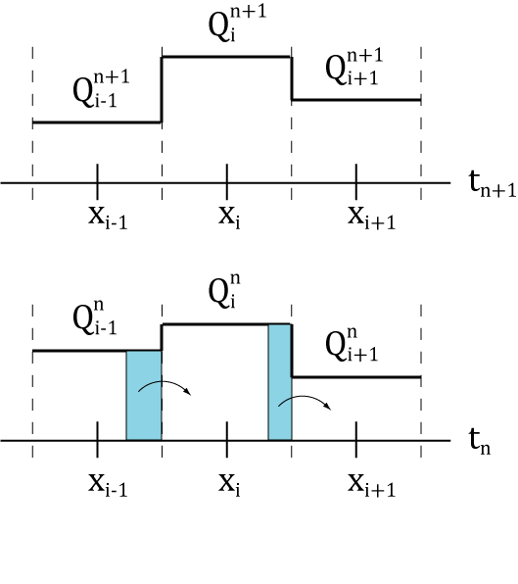
Eulerian numerical scheme

Slide 7
Langrangian approach
(Here should be a image of a man sitting on a boat and drifting down a river)
Notes:
In the Lagrangian viewpoint we consider how fluid properties vary in time at a point that moves with the fluid, so the observer this time sits on moving boat.

Slide 8
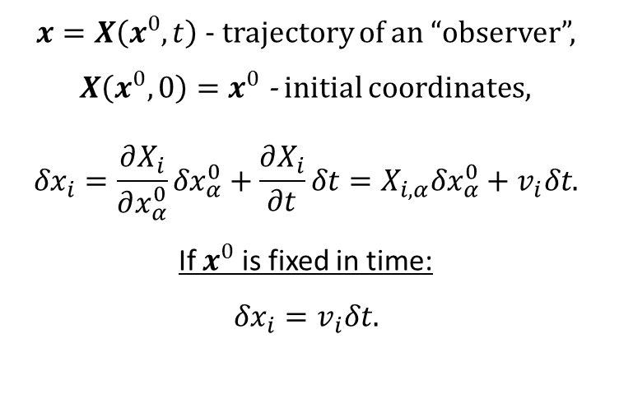
Lagrangian approach
$x=X\left(x^{0},t\right)$ - trajectory of an “observer”,
$X\left(x^{0},0\right)=x^{0}$ - initial coordinates,
$${δx}_{i}=\frac{∂X_{i}}{∂x_{α}^{0}}{δx}_{α}^{0}+\frac{∂X_{i}}{∂t}δt=X_{i,α}{δx}_{α}^{0}+v_{i}δt.$$
If $x^{0}$ is fixed in time:
$${δx}_{i}=v_{i}δt.$$
Notes:
The one important thing we can do while we are on a boat is to calculate our trajectory as follows.

Slide 9
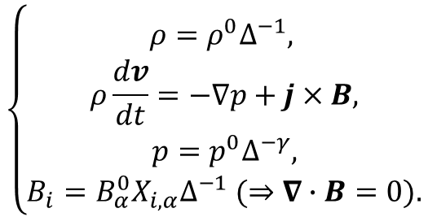
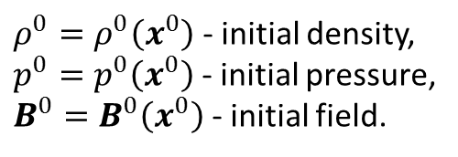

Lagrangian MHD
$$\left\{\begin{aligned} \\ ρ=ρ^{0}Δ^{−1}, \\ ρ\frac{dv}{dt}=−∇p+j×B, \\ p=p^{0}Δ^{−γ}, \\ B_{i}=B_{α}^{0}X_{i,α}∆^{−1} (⇒∇∙B=0).\end{aligned}\right.$$
$ρ^{0}=ρ^{0}\left(x^{0}\right)$ - initial density,
$p^{0}=p^{0}\left(x^{0}\right)$ - initial pressure,
$B^{0}=B^{0}\left(x^{0}\right)$ - initial field.
$$Δ=det⁡\left(X_{i,j}\right)$$
Notes:
The main advantage of this form is that the field equation now automatically conserves the divergence. The main disadvantage of this method lies in the second equation, which is written for non-conservable parameter – velocity. Moreover the energy equation was substituted with adiabatic law which also does not guarantee to save the total energy.

Slide 10
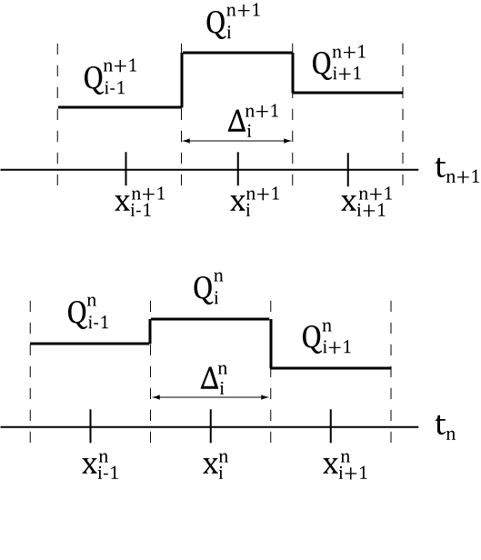
Lagrangian numerical scheme

Slide 11
Inversed Langrangian approach
(Here should be an image of a man jumping from boat to boat to stay at rest with respect to a bank of a river)
Notes:
And now I introduce an approach that I called the “Inversed Lagrangian approach”, which could be described by jumping from boat to boat while staying at rest with respect to a bank of a river.

Slide 12
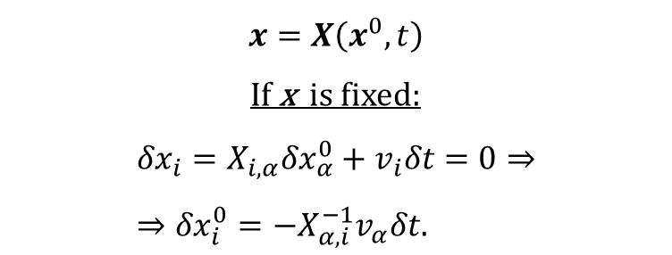
Inversed Lagrangian approach
$$x=X\left(x^{0},t\right)$$
If x is fixed:
$${δx}_{i}=X_{i,α}{δx}_{α}^{0}+v_{i}δt=0⇒ \\ ⇒{δx}_{i}^{0}=−X_{α,i}^{−1}v_{α}δt.$$
Notes:
Here is a mathematical definition of a given principle. We start from the same parcel trajectory, but this time instead of fixing the initial coordinates of a parcel we fix the current coordinates. As a result we obtain the following equation. So in this case all the dynamics is defined by the motion of initial coordinates. The cool thing now is that you have the trajectories and you are at rest, so you can you use whatever equations you want – either Lagrangian or Eulerian.

Slide 13

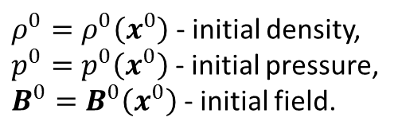
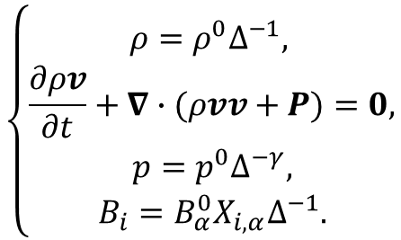
Inversed Lagrangian MHD
$$\left\{\begin{aligned} \\ ρ=ρ^{0}Δ^{−1}, \\ \frac{∂ρv}{∂t}+∇∙(ρvv+P)=0, \\ p=p^{0}Δ^{−γ}, \\ B_{i}=B_{α}^{0}X_{i,α}∆^{−1}.\end{aligned}\right.$$
$ρ^{0}=ρ^{0}\left(x^{0}\right)$ - initial density,
$p^{0}=p^{0}\left(x^{0}\right)$ - initial pressure,
$B^{0}=B^{0}\left(x^{0}\right)$ - initial field.
$$Δ=det⁡\left(X_{i,j}\right)$$
Notes:
About truncation errors!

Slide 14
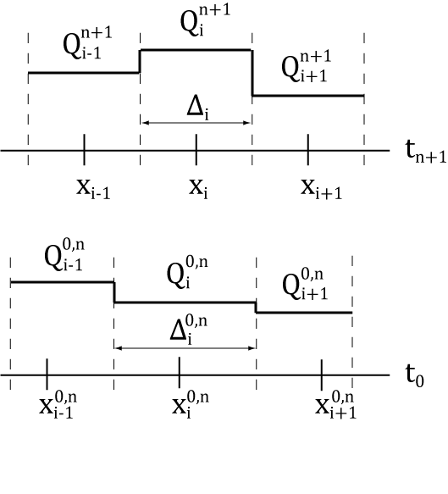
Numerical inversed Lagrangian scheme

Slide 15
Tests!

Slide 16
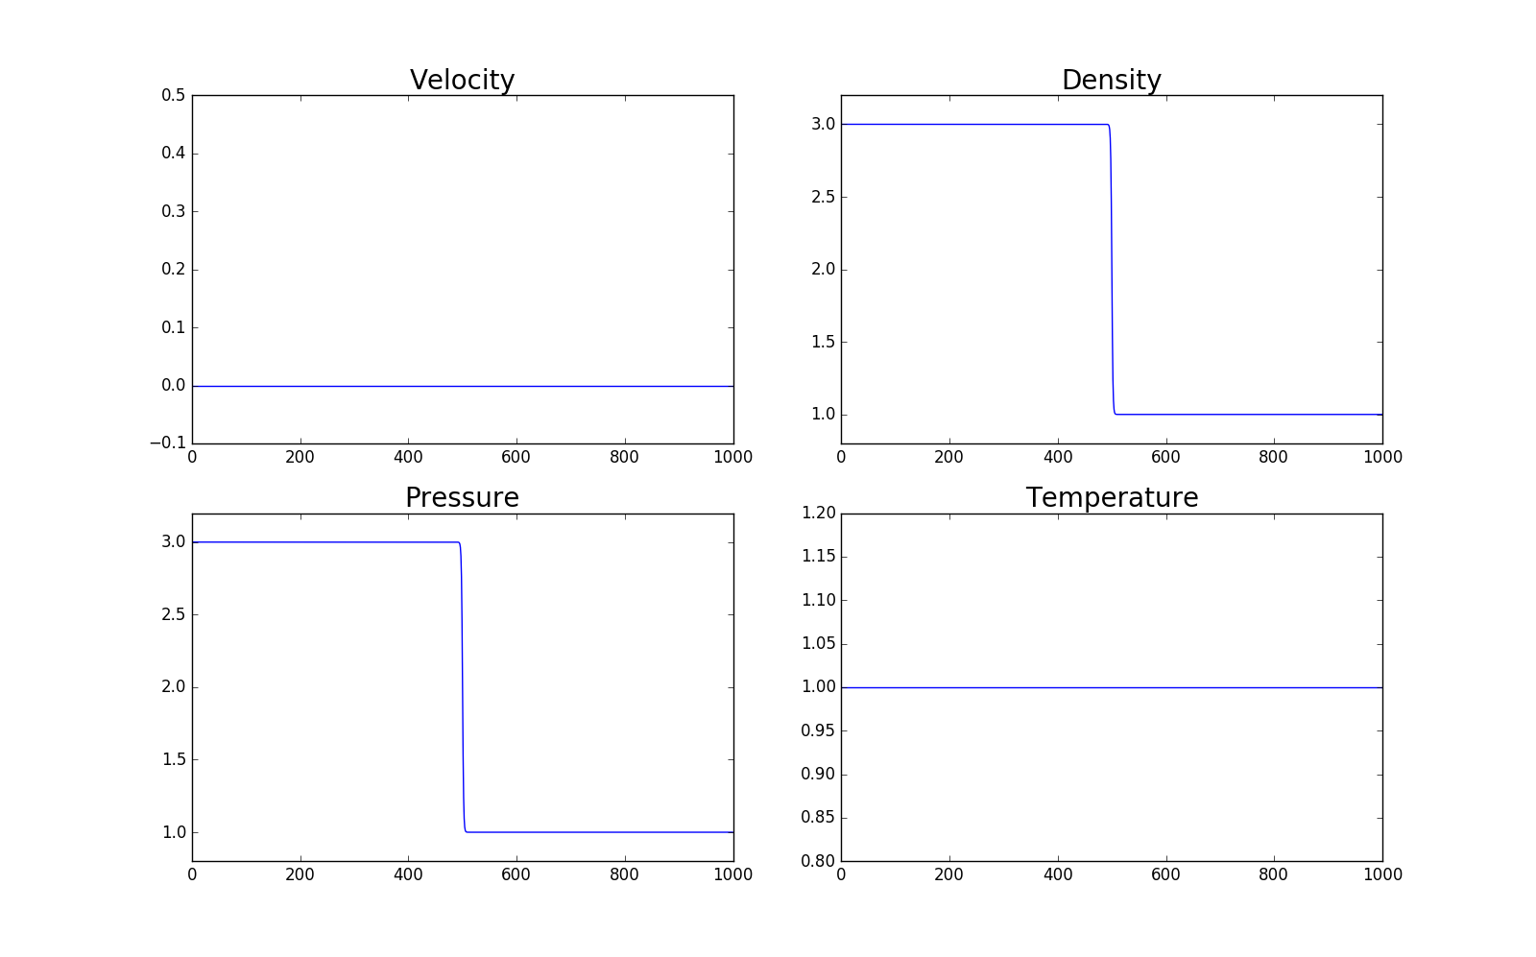
Sod’s shock tube test
Notes:
This is a well known test, called Sod’s test. It considers the dynamical response of the system to a jump in density and pressure.

Slide 17
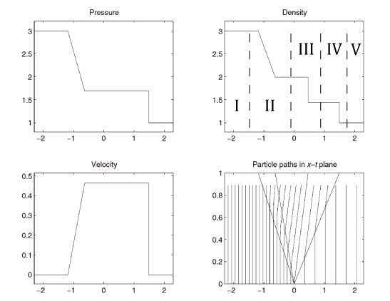
Theory
I, V – unperturbed regions
II – rarefaction wave
III – contact discontinuity
IV – shock wave
Notes:
This problem has a theoretical solution, depicted on this slide. So we see that this jump in parameters to produce a complex picture, which represents the result of propagation of 3 types of waves: first is the shock wave which has the fastest way, than follows so called contact discontinuity in which there is no jump in pressure and velocity (just density), and the third is rarefaction wave that propagates in the opposite direction.

Slide 18
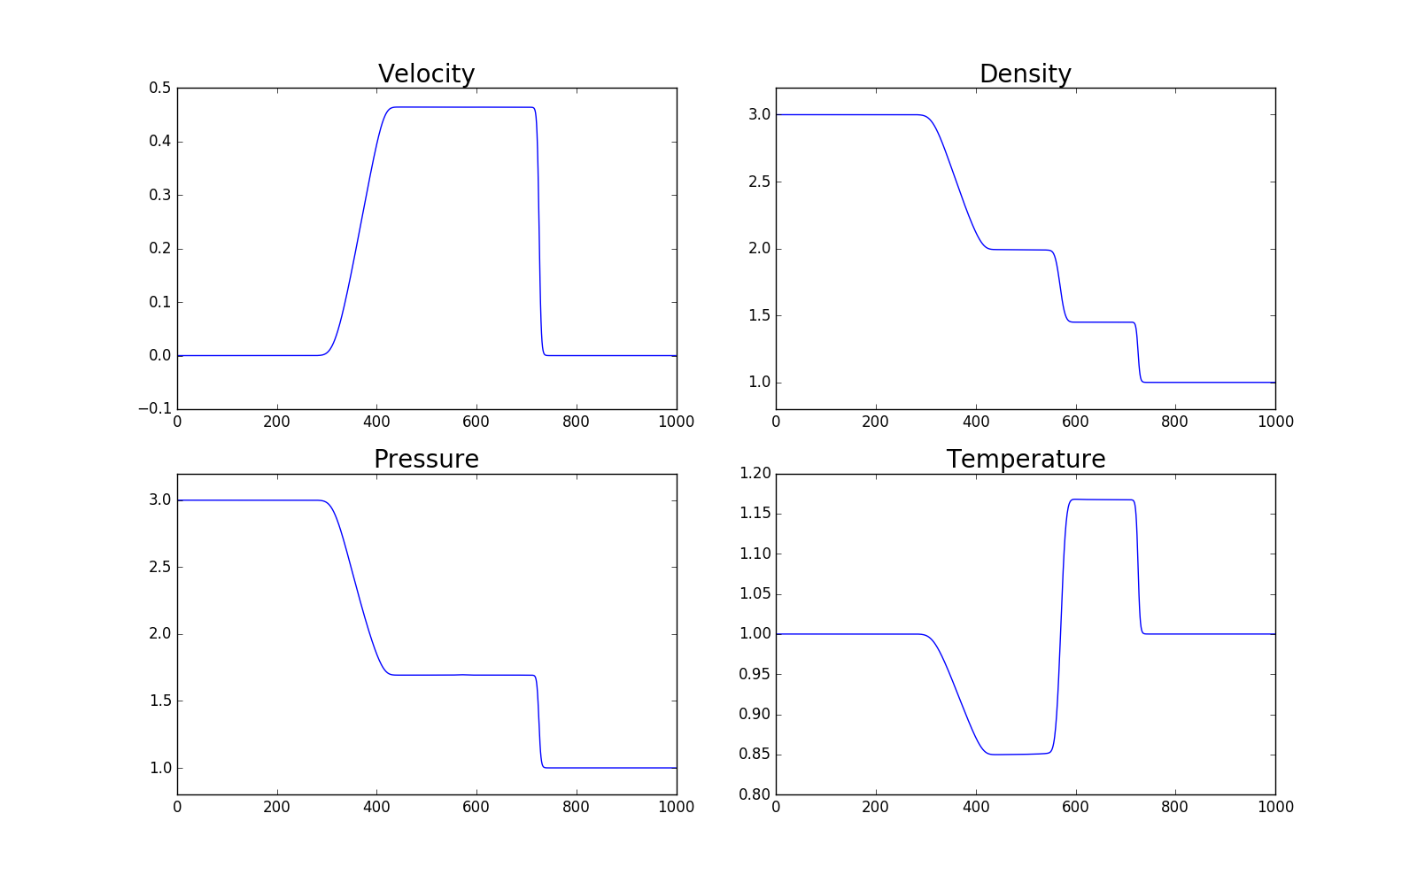
Approximate Riemann solver simulation

Slide 19
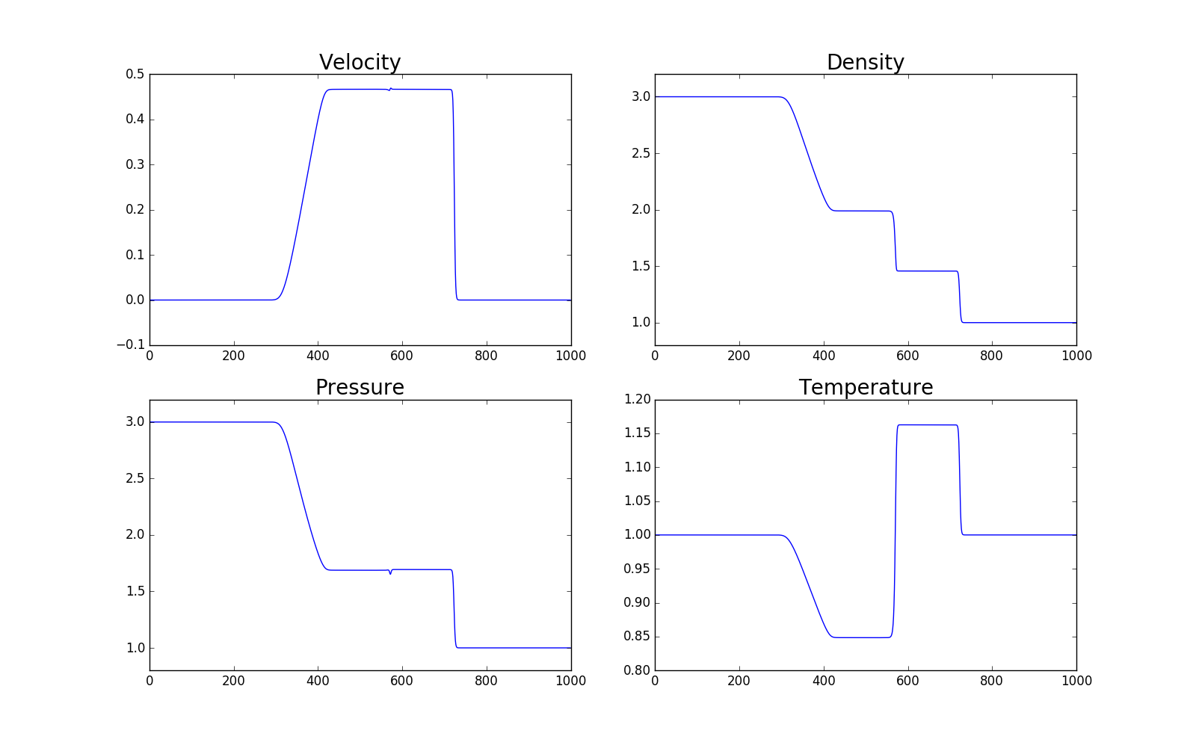
Inverted Lagrangian simulation

Slide 20
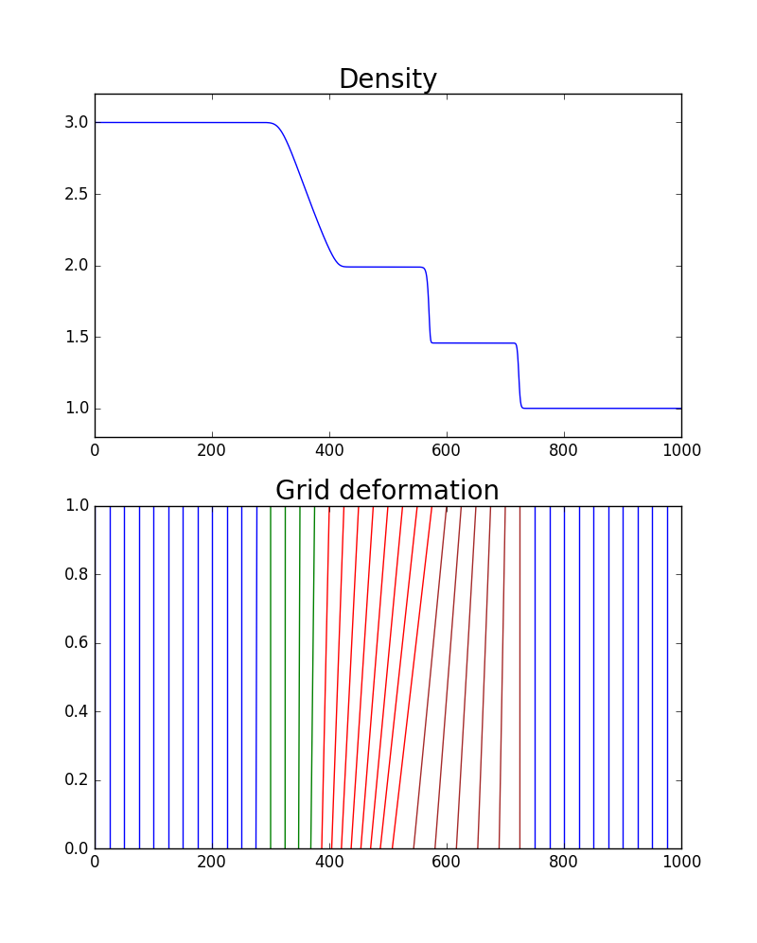
Grid deformation

Slide 21
Theory vs. Simulation
Parameter | Theory | Simulation | Inaccuracy, %
P3 | 1.693 | 1.694 | 0.02
N3 (left) | 1.994 | 1.989 | 0.2
N3 (right) | 1.451 | 1.459 | 0.4
V3 | 0.464 | 0.468 | 0.5
V4 (shock) | 1.494 | 1.487 | 0.5
Notes:
This is the comparison between theory and simulations. We see perfect correspondence in all parameters.

Slide 22
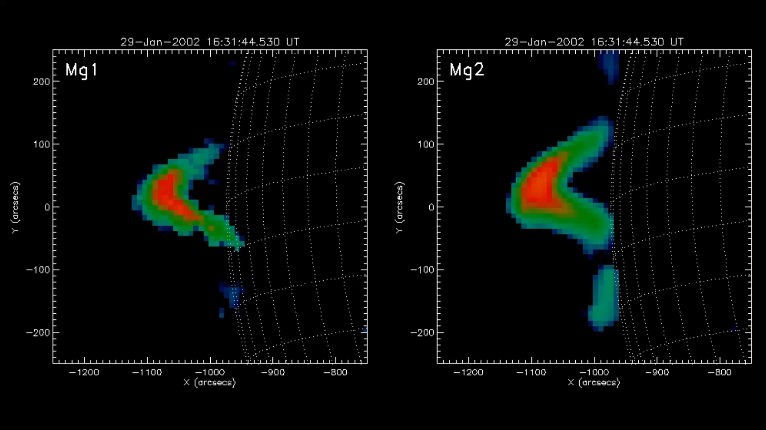
Observations - high speed flows in coronal loop

Slide 23
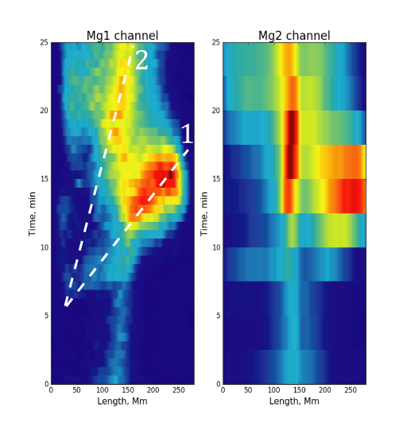
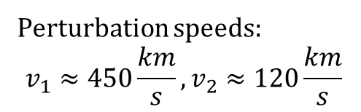
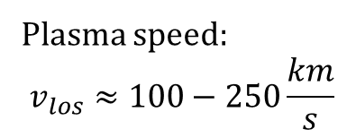
Speeds of plasma and perturbation
Perturbation speeds:
$$v_{1}≈450\frac{km}{s}, v_{2}≈120\frac{km}{s}$$
Plasma speed:
$$v_{los}≈100−250\frac{km}{s}$$

Slide 24
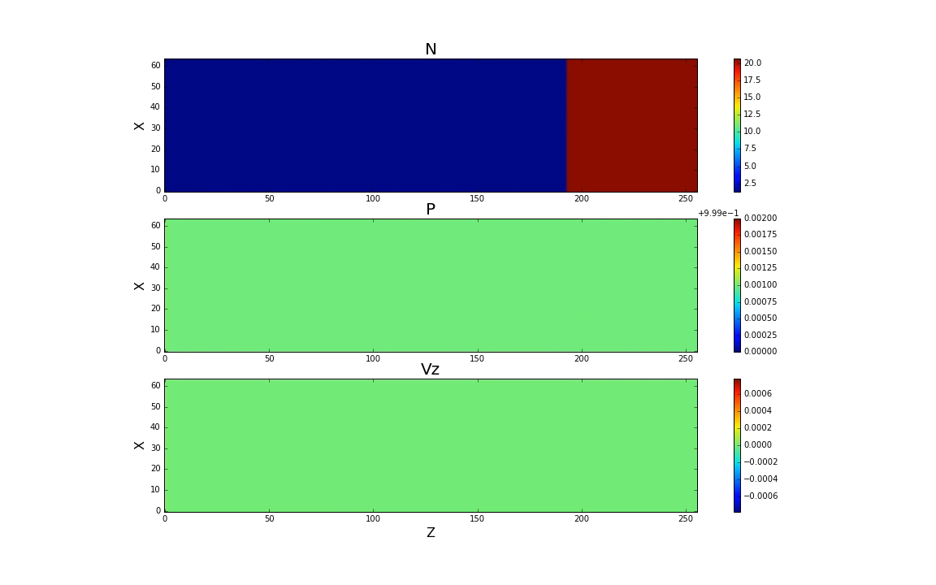
Acoustics (B=0)

Slide 25
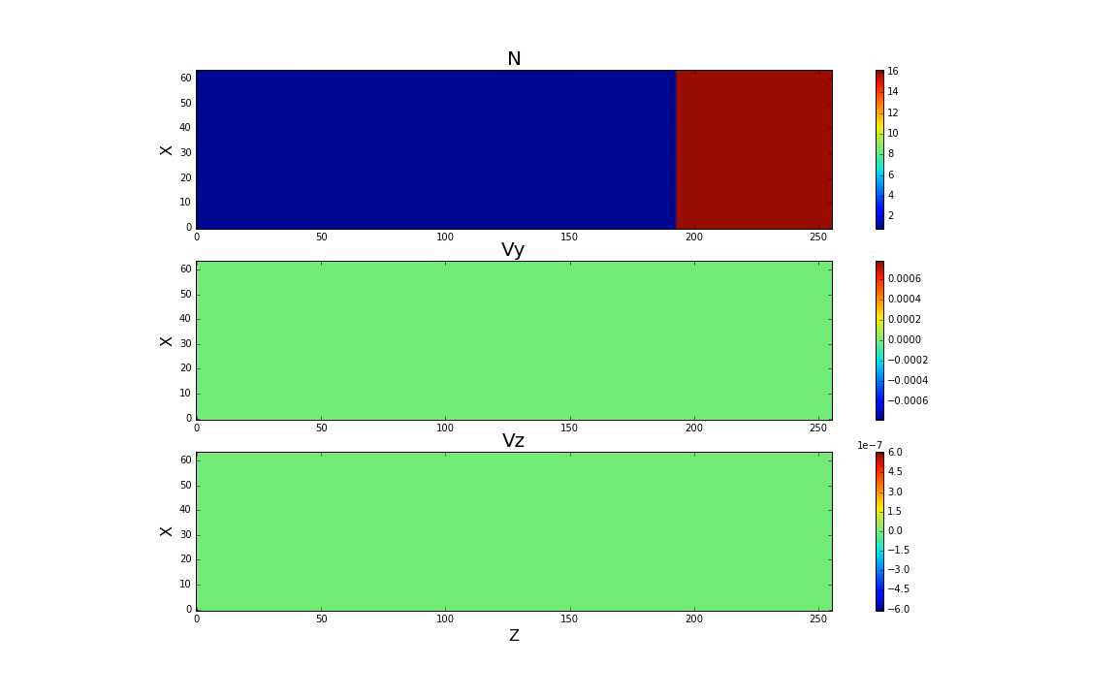
Torsional wave propagation (β = 0)
B

Slide 26
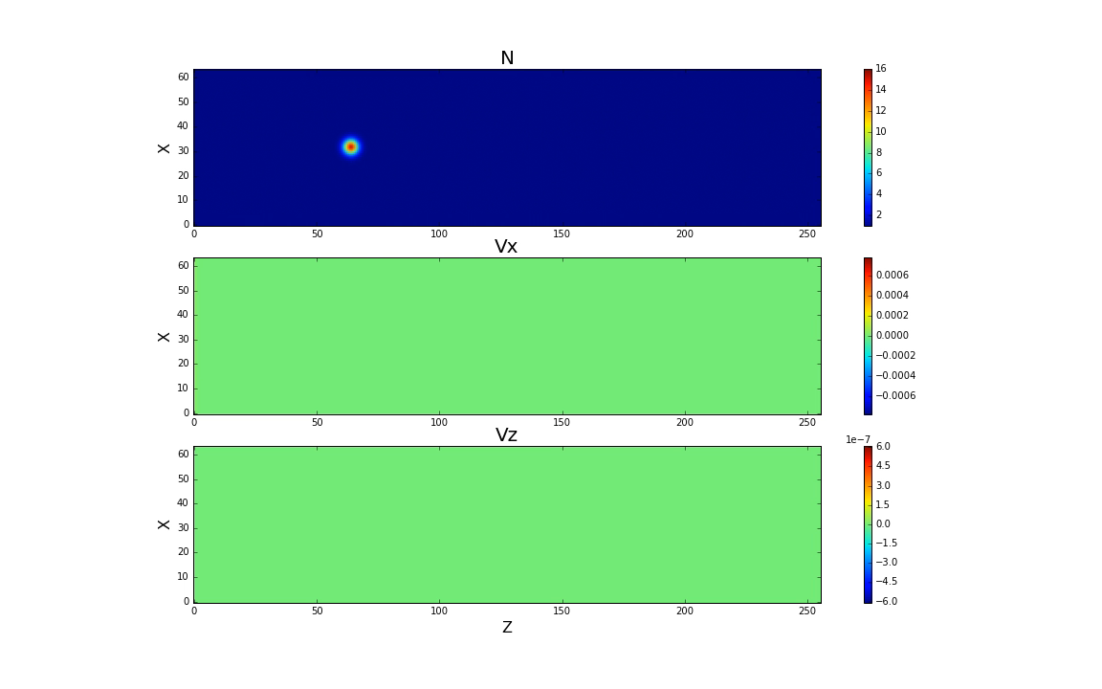
Shear wave diffraction (β = 0)
B

Slide 27
THANK YOU!

